Slide 1
AI IN FINANCIAL SERVICES
DEFECT DETECTION FOR LAPTOPS
Industry Mentor
Manu Sharma
Hewlett Packard Enterprise(HPE)
Gayathri R 22i218
Vinithaa P 22z273
Kiruthika Sermadurai 22z336
Sanjitha R 22z259
Durga G 22z321
Academic Mentor
Dr.Suriya S
CSE Department
PSG College of Technology

Slide 2
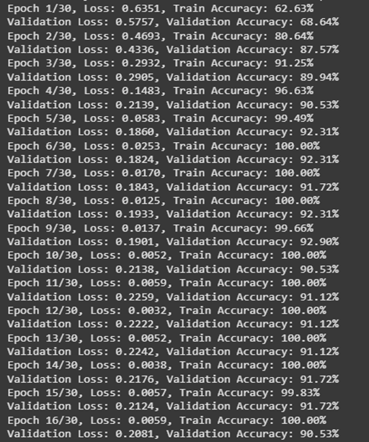
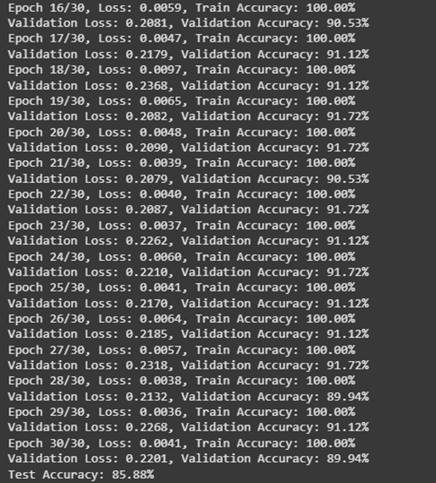
MobileNet V2 Model-Before Augmentation

Slide 3
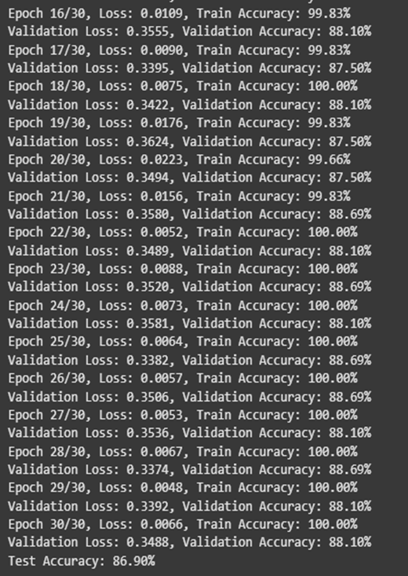
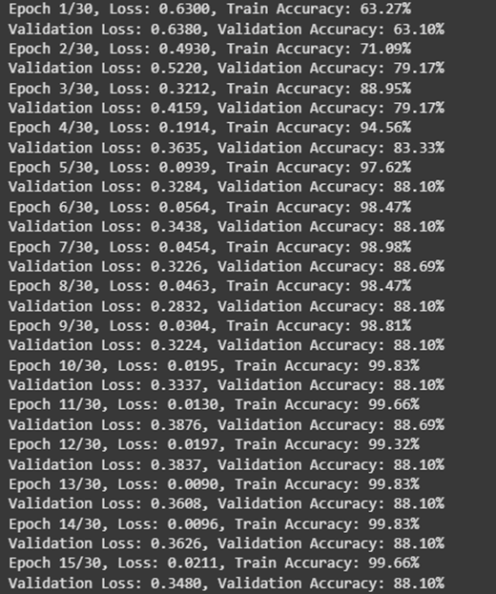
MobileNet V2 Model-After Augmentation

Slide 4
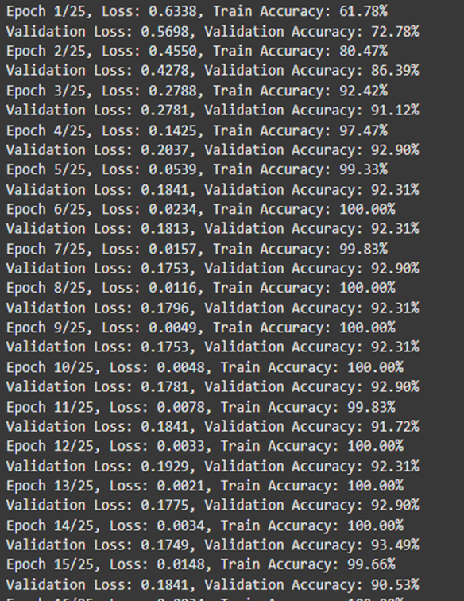
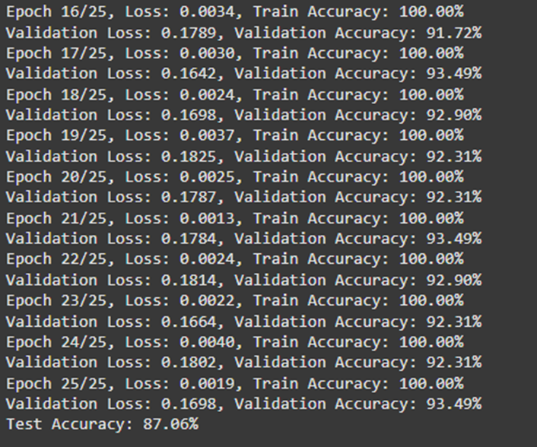
ResNet-50 Model - Before Augmentation

Slide 5
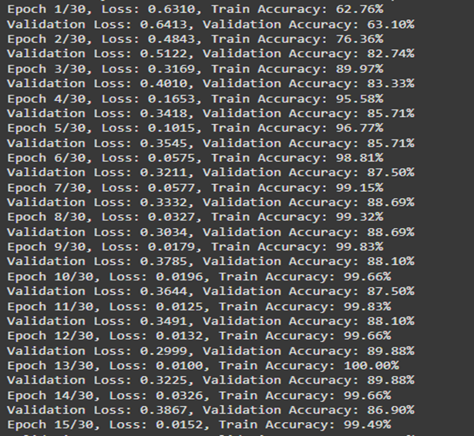
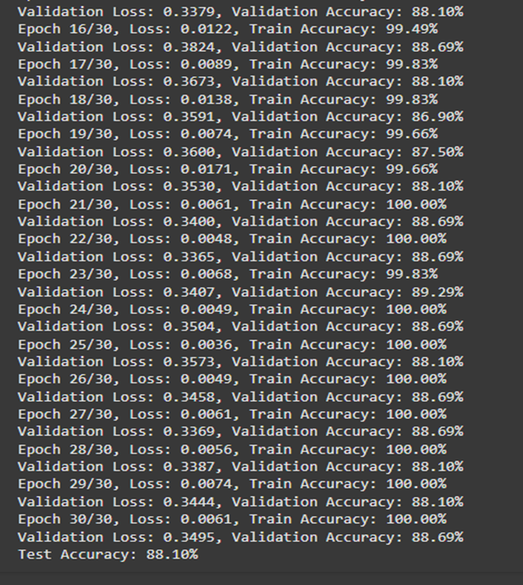
ResNet-50 Model - After Augmentation

Slide 6
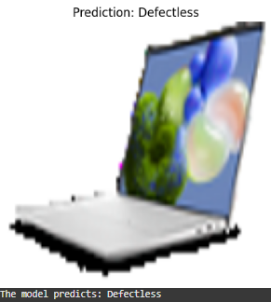
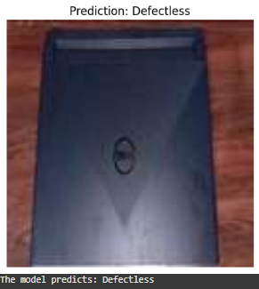
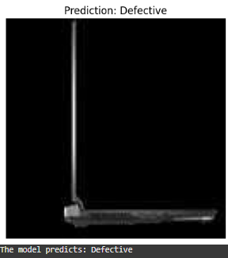
Testing MobileNet -defectless

Slide 7
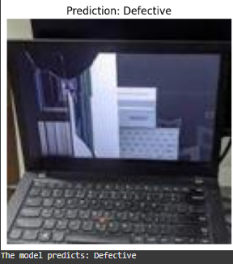
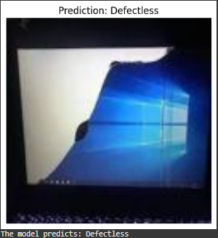
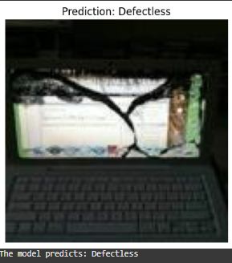
MobileNet -defect

